Slide 1
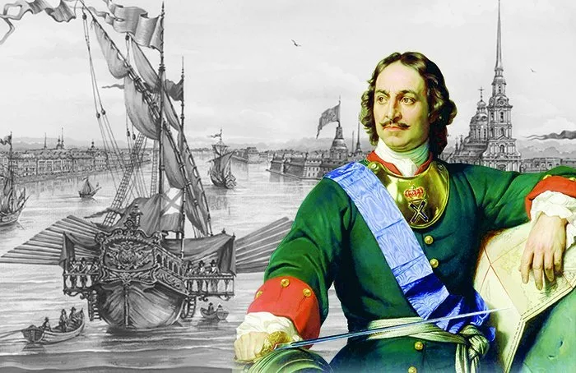
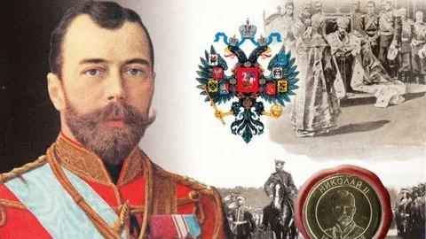
The Imperial Period of Russian History (1721-1917)
Peter I the Great (1682-1725)
Nicholas II (1894-1917)

Slide 2
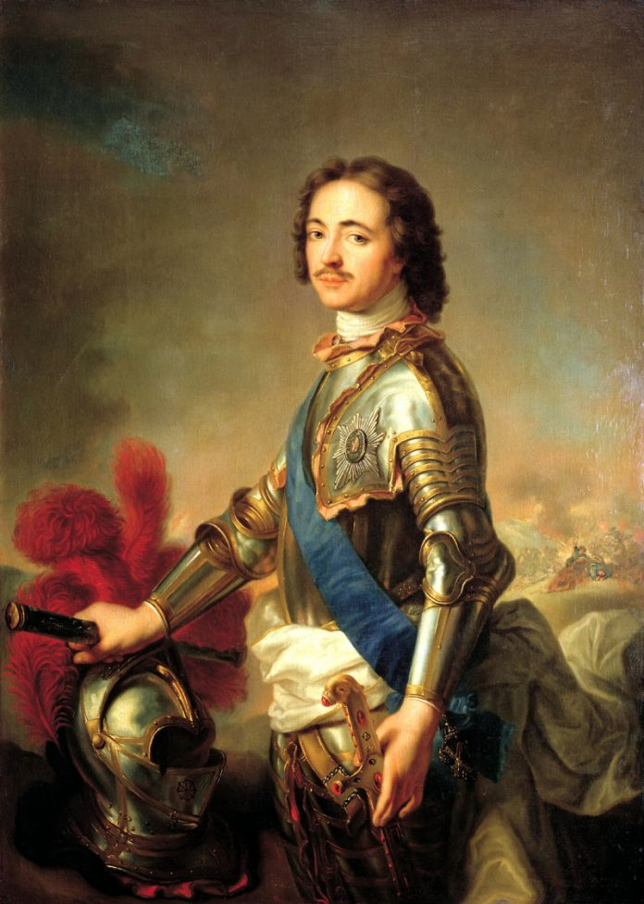
Peter the Great (1682-1721)
Foreign Policy 1689-1725.
Southern direction: The Azov campaigns (1695, 1696): the struggle against the Ottoman Empire. The beginning of Russia's establishment in the Northern Black Sea region.
Northern direction: The Great Embassy (1697-1698): the search for allies to continue the struggle against Turkey; acquaintance with the art of war, the way of life of Europe. The Northern War. 1700-1721. The reasons for the war: Sweden's desire for supremacy in the Baltic; the need for Russia to enter the Baltic; Sweden's geopolitical contradictions with other European powers. The Battle of Poltava – 1709. 1721 – The Nishtadt Peace Treaty; proclamation of Russia as an empire. Terms of the agreement: Russia received the territories of the Baltic States, part of Karelia, access to the Baltic Sea, was obliged to pay monetary compensation to Sweden and return Finland.
The eastern direction: The 1689 Treaty of Nerchinsk with China. The Persian War. (The Caspian Campaign. 1722-1723): creating the prerequisites for Russian expansion into Central Asia and Transcaucasia.

Slide 3
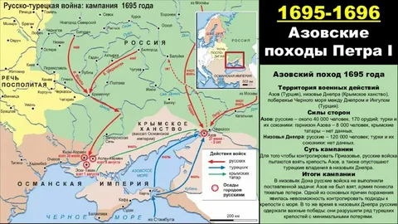
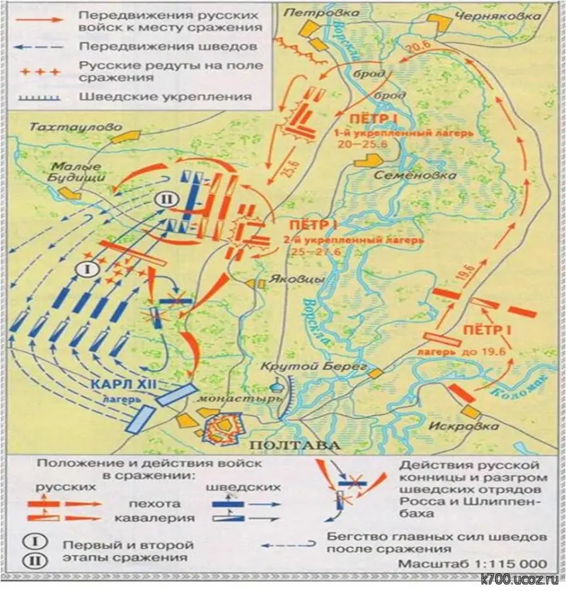
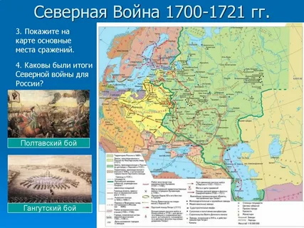
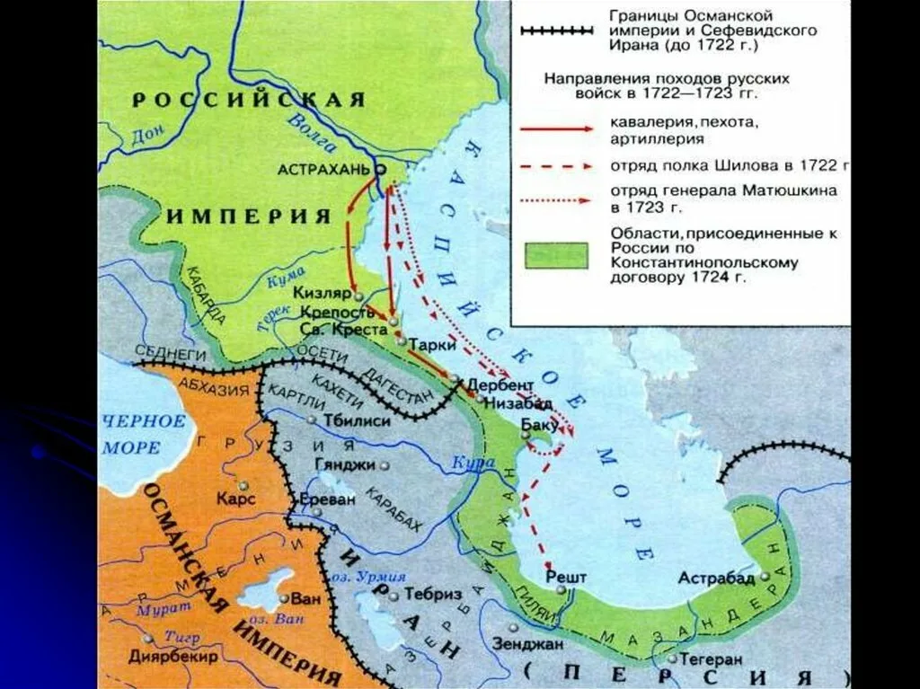

Slide 4
Peter I the Great domestic activities.
The goal of Peter the Great's reforms is to gain Russia's competitive advantage over other European states through the adoption and implementation of advanced technologies of state, military and technical development.
Peter's reforms:
1) Military reform. Of the 36 years of Peter I's reign, Russia fought for 28 years. Regular shelves. A qualitatively new fleet. Qualitatively new artillery. Training of military personnel. Development of new military legislation – Military Regulations of 1716, Naval Regulations of 1720. Unification of uniforms and armaments by branches of the armed forces. New principles of formation (conscription), quartering, and maintenance in peacetime.
2) The reform of government and management (Established in 1711 The Senate is the highest body of legislative, executive and judicial power. The Senate replaced the Boyar Duma. Creation of 9 colleges in 1718).
3) Economic reform (by 1725, about 200 manufactories and the same number of small craft enterprises. The introduction of taxes, including the poll tax, which provided 53% of the estimated income. Trade: exports of goods exceeded imports by two times. The center of foreign trade has moved from Arkhangelsk to St. Petersburg).
4) Social reform (The boyars disappeared as a class. It became part of the nobility. The Table of ranks of 1722 divided the urban population into 2 categories – regular and irregular citizens. The first is merchants, industrialists, and bankers. The second group consists of small traders and craftsmen. The rest are "vile people." Rural population: peasants, serfs, free people, odnodvorets, black-shod peasants (north), arable people of Siberia, yasachny people of the Middle Volga region). - 1703 – decree on attributed peasants (state, palace and economic peasants who, instead of paying poll taxes, worked in state-owned or private factories and factories, that is, attached (attributed) to them). - 1721 – decree on concession peasants (attached to the manufactory, could not be sold separately from the enterprise). - 1718-1724 – poll tax (replacement of household tax).
5) Church reform (in 1721, the Ecclesiastical College (the Holy Synod) was established, so the patriarchate was liquidated. The church became part of the state mechanism: the members of the Ecclesiastical College were appointed by the tsar from among the clergy).

Slide 5
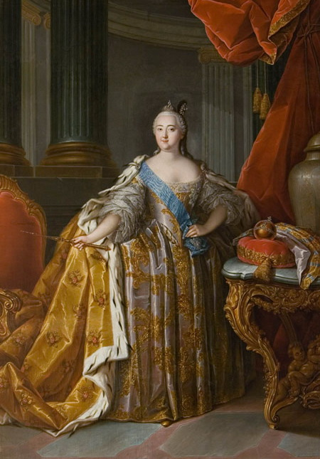
The Empress Elizabeth (1741–1761)
Foreign policy
On May 17, 1756, England's attack on France began the Seven Years' War.
On December 31, 1756, the act of Russia's accession to the Treaty of Versailles on the alliance of Austria with France was signed.
On January 22, 1757, an agreement was signed in St. Petersburg between Russia and Austria, confirming the terms of the 1746 treaty between them and directed against Frederick II.
In early 1758, Russia occupied East Prussia, including its capital, Konigsberg.
In 1760, Russian troops entered Berlin
Domestic policy:
- the spread of education, the establishment of universities and gymnasiums,
- destruction of internal customs offices,
- the abolition of the death penalty and some relaxation in legislation regarding the use of torture in investigations

Slide 6
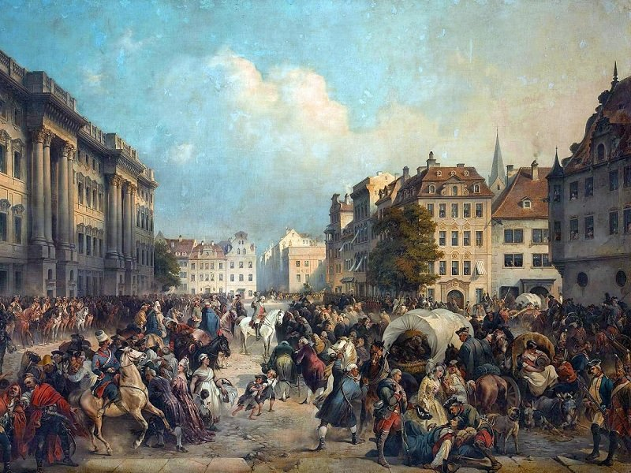
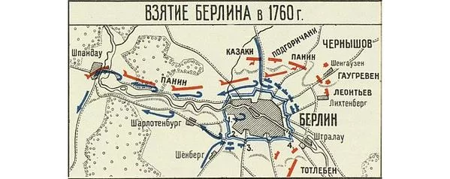
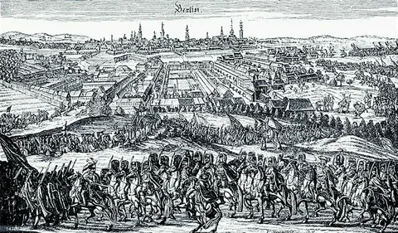
The capture of Berlin, the capital of Prussia, by Russian troops in 1760 (7years war)

Slide 7
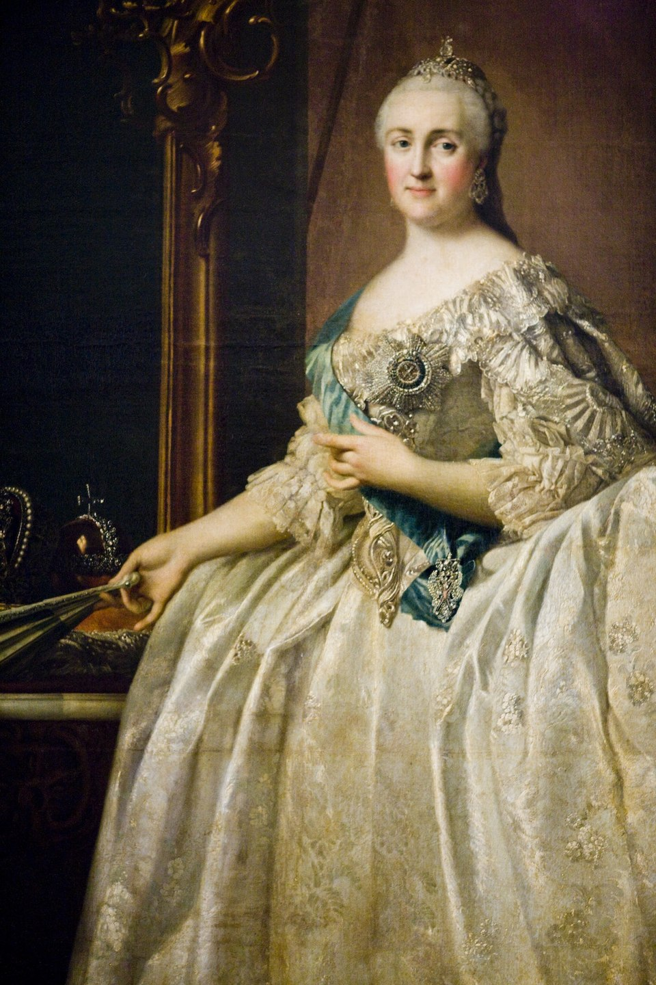
Catherine the Great (1762–1796)
The tasks of the "enlightened monarch" in the view of Catherine II:
"It is necessary to educate the nation, which should be governed by an enlightened monarch.
It is necessary to introduce good order in the state, support society and force it to comply with the laws.
We need to establish a good and accurate police force in the state.
It is necessary to promote the flourishing of the state and make it abundant.
It is necessary to make the state formidable in itself and inspiring respect for its neighbors."

Slide 8
Domestic policy
- July 6, 1762 – the assassination of Peter III in Ropsha.
- October 14, 1762 – decree allowing all foreigners to settle in Russia - 1764 – secularization of church and monastery lands.
- 1765 – creation of a Free Economic Society headed by Grigory Orlov to help noble entrepreneurship.
- 1765 – decree authorizing landowners to send serfs to hard labor.
- 1767 – decree prohibiting peasants from complaining about landlords.
- 1767-1769 –Completed the commission.
- January 11, 1768 – the establishment of the Assignation Bank and the introduction of banknotes (paper money).
- 1773 – the foundation of the Mining Institute in St. Petersburg.
- 1773-1775 – the peasant War led by Yemelyan Pugachev.
- 1775 – provincial reform (shifting the center of gravity of government to places).
- 1775 – the abolition of Cossack self-government on the Don and the destruction of the Zaporozhian Sich.
- 1782 – the opening of the monument to Peter I (the Bronze Horseman) in St. Petersburg.
- 1785 – The letter of commendation to the nobility.
- 1786 – Loan bank.

Slide 9
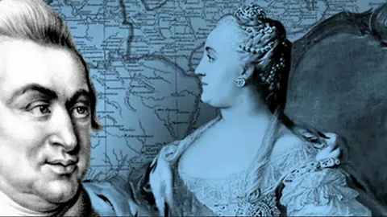
Foreign Policy
Tasks:
the struggle for access to the Black and Azov Seas.
liberation of the lands of Ukraine and Belarus from foreign domination and unification of all Eastern Slavs in one state.
annexation of Crimea.
the struggle against revolutionary France.
Main directions: western, southern.
1766 – the annexation of the Aleutian Islands to Russia.
1768-1774 – The Russian-Turkish War (June 26, 1770 – the defeat of the Turkish fleet in the Chesma Bay). Kuchuk-Kaynardzhi Peace Treaty.
1783 – annexation of Crimea and lands along the Kuban River to Russia. The liquidation of the Crimean Khanate.
Russia's participation in the partitions of Poland: 1772-1773; 1793; 1796.
1783 – the acceptance of eastern Georgia under the patronage of Russia. (Annexation of all Georgia – January 18, 1801)
1787-1791 – Russian-Turkish War. The Iasi Peace Treaty: Russia gained access to the Black Sea.
1788-1790 – Russian-Swedish War.
Attempts to counter the French Revolution (1786-1794): diplomatic and trade relations with France were severed.
Foreign policy results:
- Russia has gained access to the Black Sea.
accelerated economic development of the steppe south of Russia.
- liquidation of the Crimean Khanate.
- the foundation of new cities: Nikolaev, Odessa, Sevastopol, Kherson, etc.
- expansion of trade relations between Russia and the Mediterranean countries.
-The partitions of Poland pushed the borders of the Russian Empire to the West (Belarus and Ukraine).
- Russia's authority as a great power has increased.

Slide 10
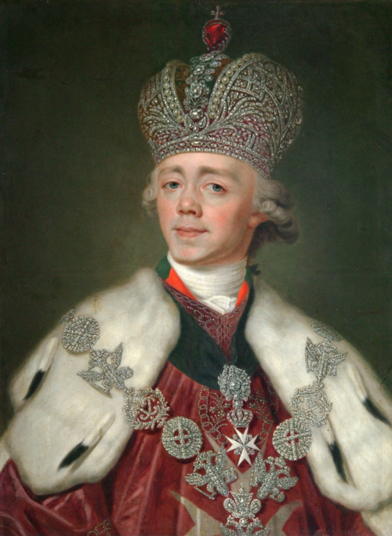
Paul I (1796–1801)
Domestic policy:
- restoration of the Collegium system.
- changing the administrative division of Russia, reducing the number of provinces,
- the return of the previous forms of government in the provinces of Russia.
- Depriving the nobility of privileges;
- limitation of the validity of chartered certificates;
- attempts to stabilize the country's financial situation;
- establishment of the standard of peasant labor;
- changing the system of succession to the throne.
- 1797 – decree prohibiting the sale of household servants and landless serfs; publication of a Manifesto on three-day Servitude.
Foreign policy:
- A change in foreign policy: a reorientation towards an alliance with France.
- 1798-1800 – Russian-French wars.
- 1798-1800 – Italian and Swiss campaigns of A.V. Suvorov, the Mediterranean campaign of F.F. Ushakov.

Slide 11
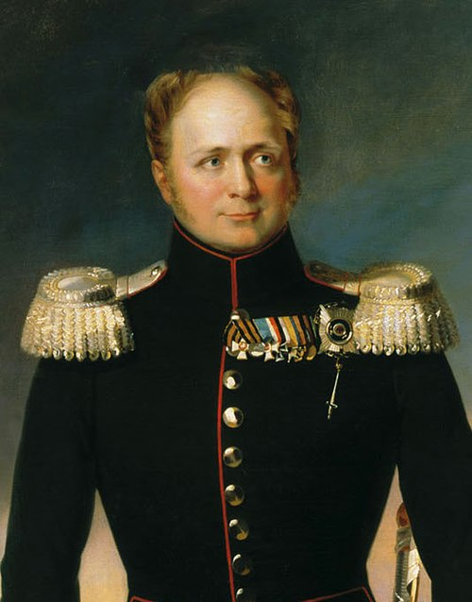
Alexander I (1801–1825)
Domestic activities
1802 – Manifesto on the establishment of ministries.
1803 – decree "On free farmers.“
1809 – compilation by M.M. Speransky of the "Introduction to the Code of State Laws". It is based on the principle of separation of powers - legislative, executive and judicial, which were combined in the State Council. The real legislative power remained in the hands of the Emperor.
1810 - creation of the State Council. Development of water transport. The Mariinsky and Tikhvin canal systems
1810-1811. - Military settlements. 1810-1857. Organizer: General A. Arakcheev.
1815 – opening of the first steamship line in Russia "Saint Petersburg-Kronstadt".
1815 – granting of the constitution to the Kingdom of Poland
1816-1819 – granting personal freedom to the peasants of the Baltic provinces.
1819 – Chuguev uprising of military settlers in Ukraine.
1821. N.N.Novosiltsev. The draft Constitution "The State Charter of the Russian Empire".
Decree of Alexander I of 1822 on the restoration of the rights of landlords to send serfs to settle in Siberia "for bad deeds".

Slide 12
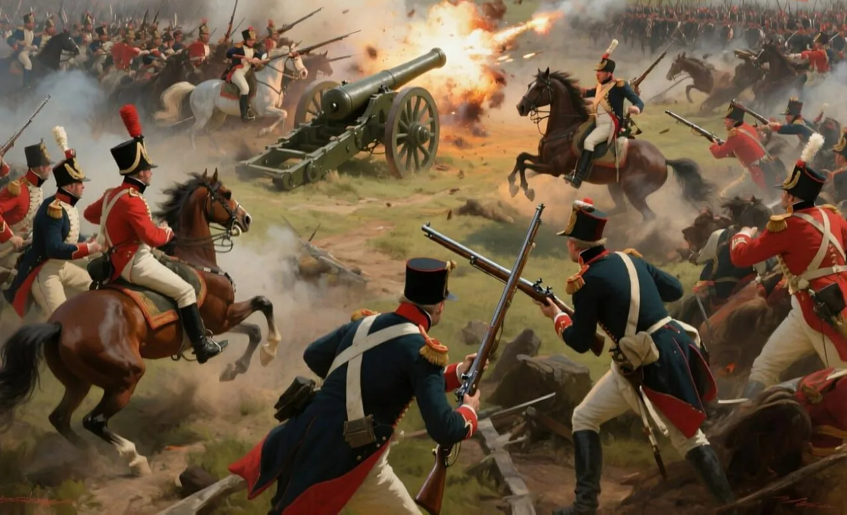
Foreign affairs
- 1805-1807 – Russia's participation in the anti-Napoleonic coalitions.
- June 25, 1807 – The Peace of Tilsit (the formation of the Russian-French union and the division of spheres of influence).
- The Russian-Turkish War of 1806-1812. Bucharest Peace Treaty1808-1809 – Russian-Swedish War. The Friedrichsham Peace Treaty. Finland's entry into Russia.
Causes and outbreak of the Patriotic War of 1812:
- political and economic contradictions between Russia and France,
- France's desire for European hegemony,
- Russia's refusal to support the continental blockade of England.
- June 24, 1812 – invasion of Napoleon's army in Russia.
- August 16-18, 1812 – Battle of Smolensk.
- August 26, 1812 – Battle of Borodino.
September 1, 1812 - Council in the village of Fili.
On September 2, 1812, Napoleon entered Moscow.
The Tarutino maneuver.
Actions of partisan detachments.
October 7, 1812 - Napoleon left Moscow
- October 12, 1812 – Battle of Maloyaroslavets.
- November 14-16, 1812 – French troops crossed the Berezina.
On December 23, 1812, the tsarist manifesto on the end of the Patriotic War was issued.
- January 14, 1813 – the beginning of the liberation of Europe from Napoleon's troops. The 5th anti-French coalition (Russia, Prussia, England, Sweden, Austria).
- October 16-19, 1813 – The "Battle of the Nations" at Leipzig. The defeat of Napoleon.
- 1813-1814 – the Russian army's overseas campaign.
- March 18, 1814 – the entry of the Allied forces into Paris.
- September 1814 – June 1815 – Congress of Vienna.
- 1815 – foundation of the "Holy Alliance" of monarchs.
- 1825-1855 – reign of Nicholas I.
- 1826-1828 – the Russian-Iranian War.

Slide 13
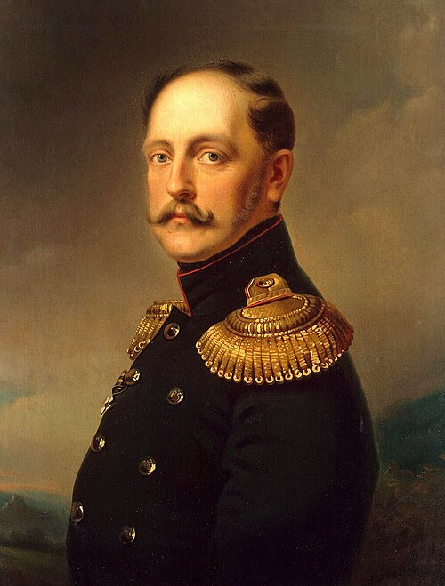
Nicholas I (1825–1855)

Slide 14
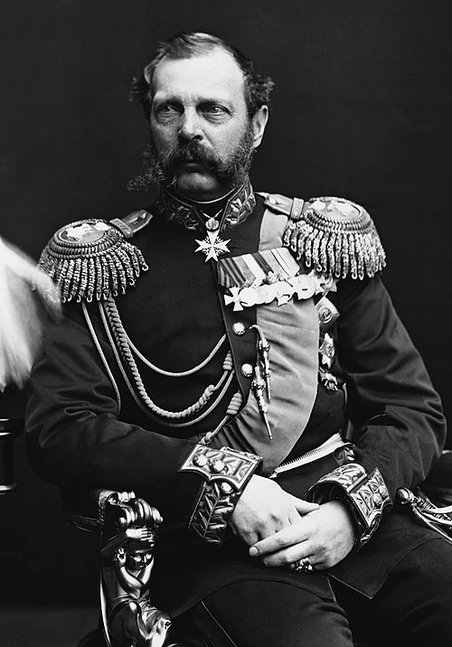
Alexander II (1855–1881)

Slide 15
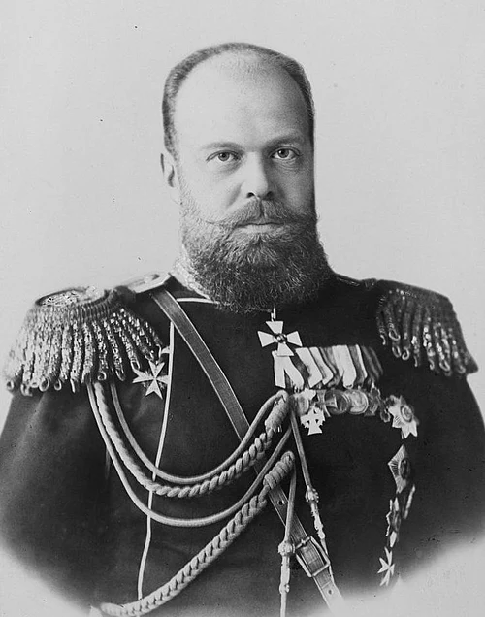
Alexander III (1881–1894)

Slide 16
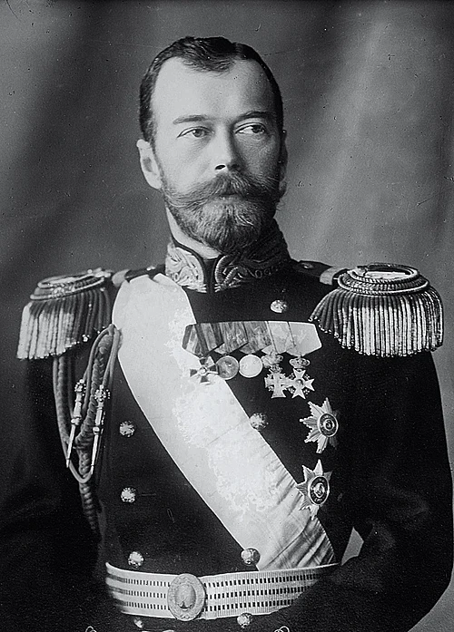
Nicholas II (1894–1917)

